Slide 1
AE Cloud 2 S5D9 Arduino Basic Examples
By Michael Li (3/26/2019)

Slide 2
Basic Example Library
Example | Hardware Setup
1. Blink on board LED | None | Green LED blinks every 1 second using delay function.
2. Digital Write | None | Square wave on D[4:2] pins.
3. Digital Write and Read (LED and Button) | LED (D2), 220 ohm resistor and Button (D3) | Push down the button to turn on the external LED.
4. PWM (LED) | LED + 220 ohm resister (D5, D6) | Pulses with changing duty cycle on D[6:5]. LED diming.
5. Analog Input (Pot + LED) | Pot (ADC0) + LED (D5) | Use the potentiometer to control the brightness of the LED.
6. Millis delay function | None | Green LED blinks every 1 second using millis function.
7. Interrupt 0 & 1 test | 3 LEDs required | Int 0 toggles Red Led for both rising and falling edge triggers while Int 1 toggles Green LED only for rising edge triggers.
8. Serial 1 Write | UART to USB converter | Writing data to the PC terminal program (ie Putty)
9. Serial 1 Read | UART to USB converter | Echo what is received from the PC terminal program (ie Putty)

Slide 3
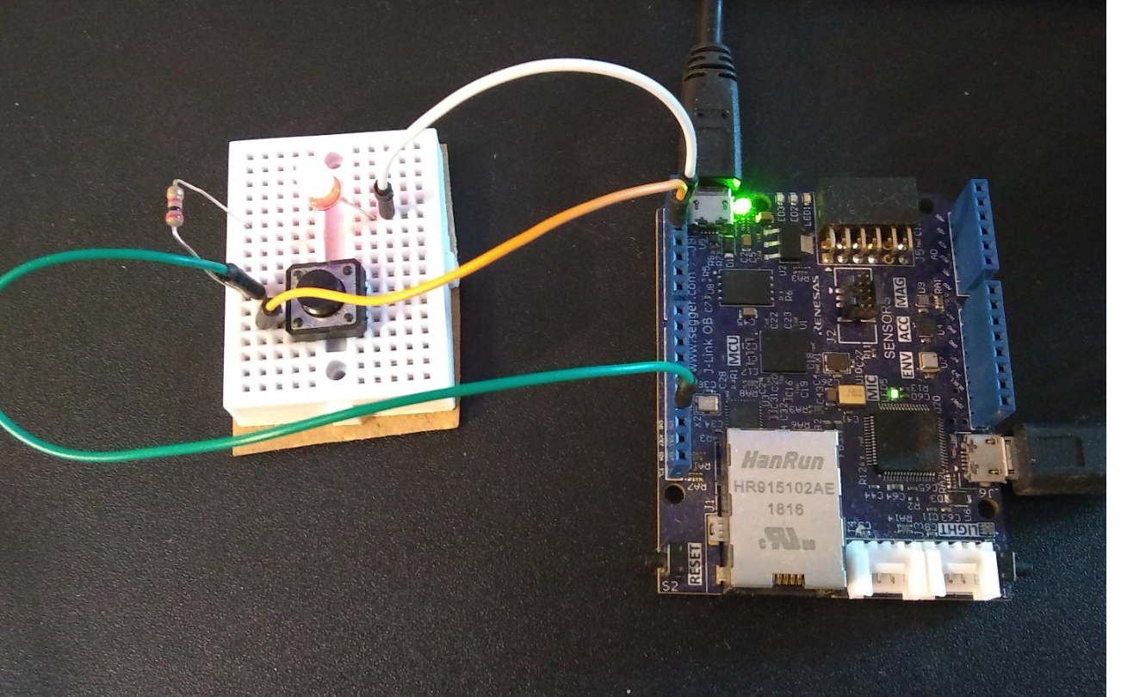
Example 3: Digital Write and Read (LED & Button)

Slide 4
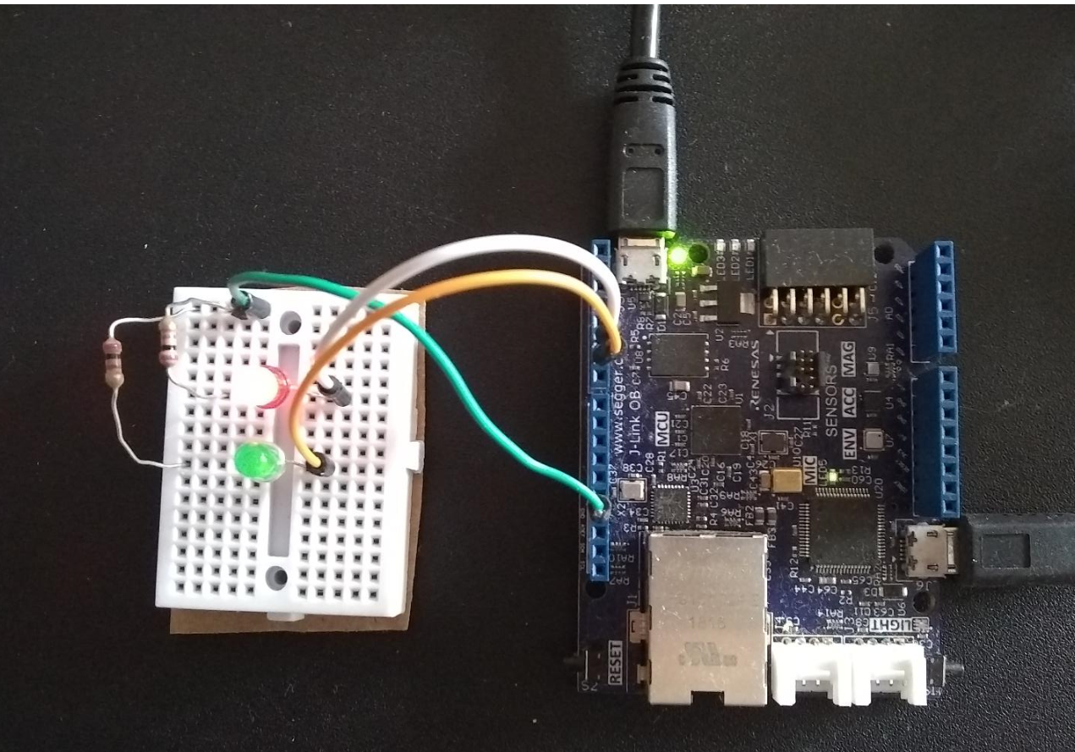
Example 4:PWM (LED diming)

Slide 5
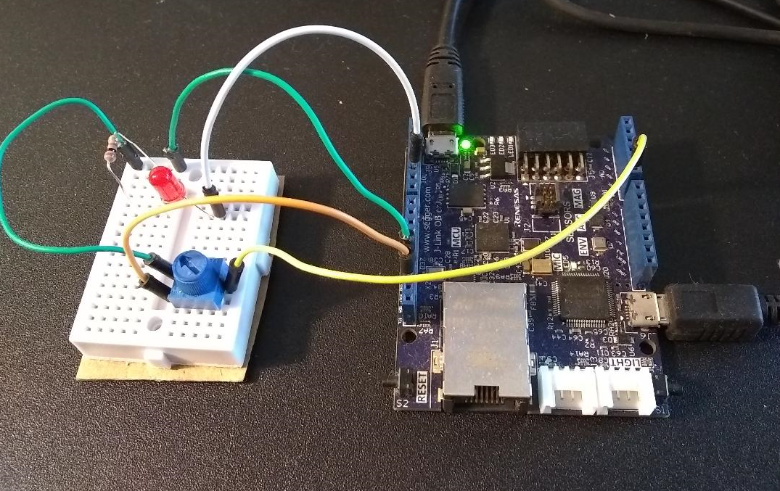
Example 5: Analog Input (Pot + LED)

Slide 6
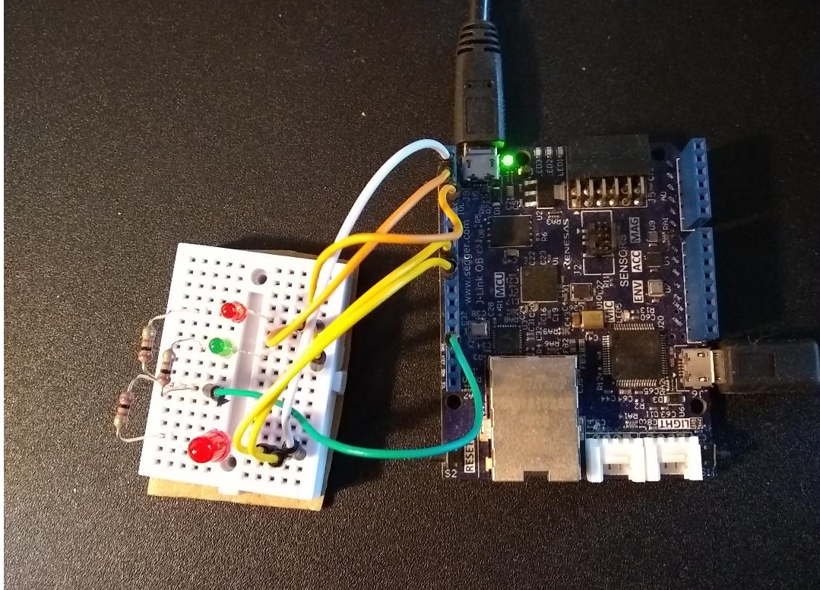
Example 7: Interrupt 0 & 1
Every 4 Big Red Led toggles, the interrupt is disabled. (Please see the example code for details)
INT0 : small Red Led toggles with big Red Led.
INT1 : small Green Led toggles only when big Red Led turns from off to on.
Big Red Led : (pin 2 toggle pin to INT0 & INT1)

Slide 7
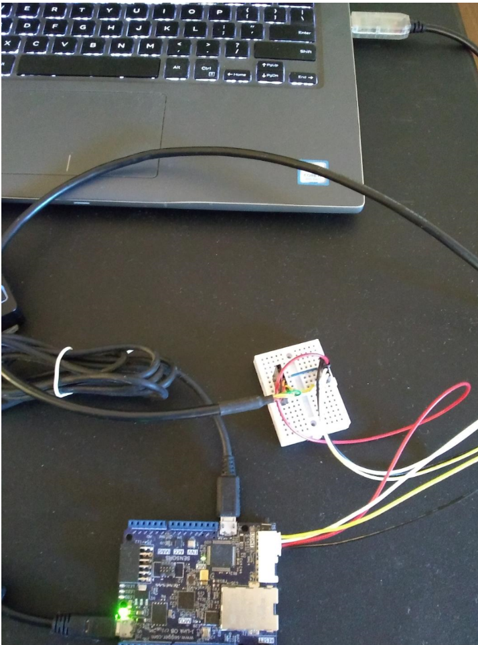
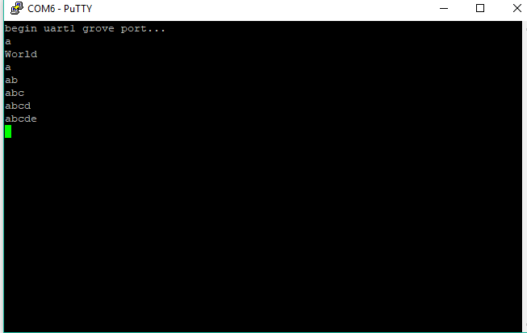
Example 8: Serial 1 Write

Slide 8
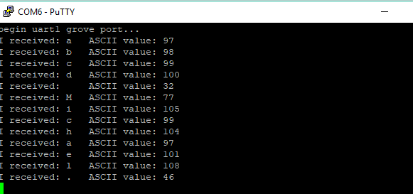
Example 9: Serial 1 Read

